Slide 1
Join the
conversation
using Slido

Slide 2
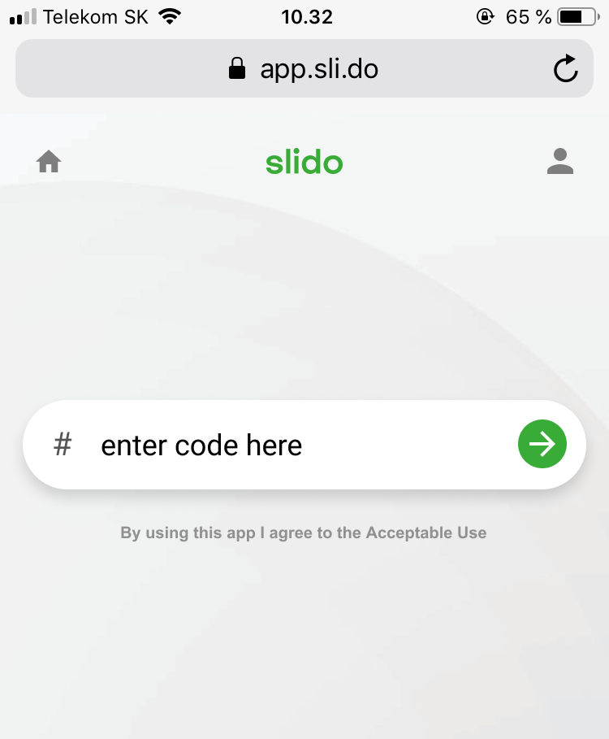
Go to slido.com and enter the event code:
#eventcode
Enter event code

Slide 3
Join the conversation
Open browser
Go to slido.com
Enter event code

Slide 4
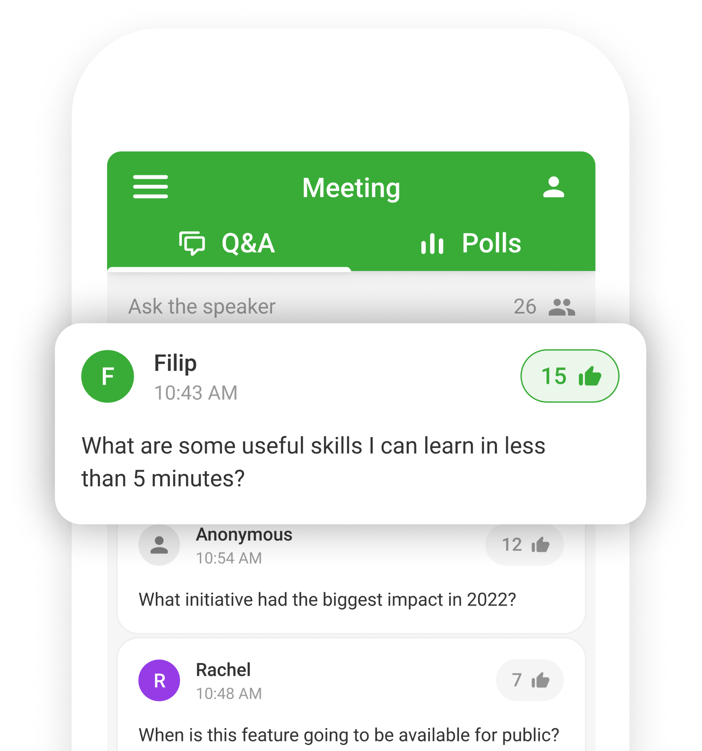
Ask questions and upvote the ones you like

Slide 5
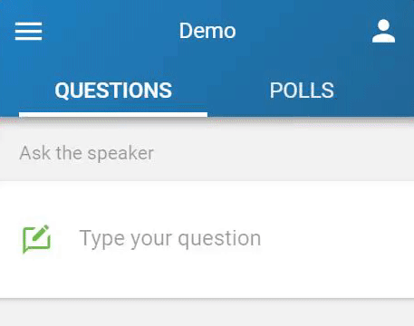
Stay anonymous
or attach your name
to the question

Slide 6
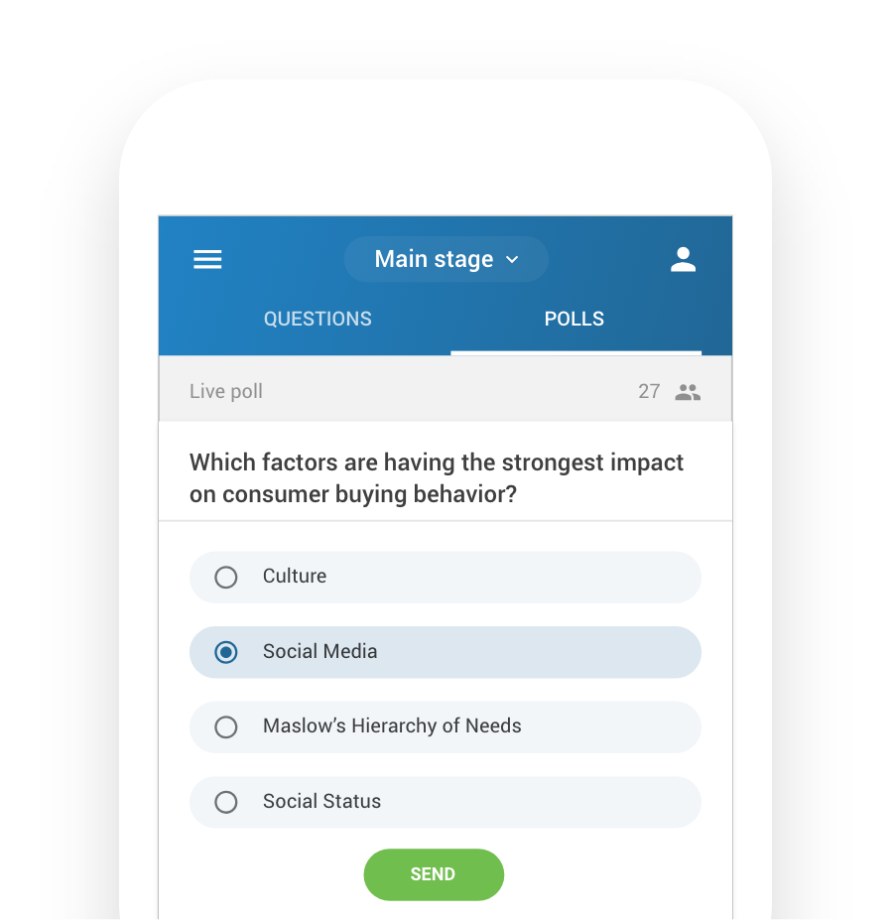
Share your thoughts
and opinion by voting
in live polls

Slide 7
Questions and votes
will appear in real-time
on an interactive wall

